Slide 1
ECOLOPES DEMO
Mehmet Akif Cifci

Slide 2

Presentation Index
Introduction
Main Interface
Connection Settings
Machine Learning
Rhino3D
Q&A Session

Slide 3
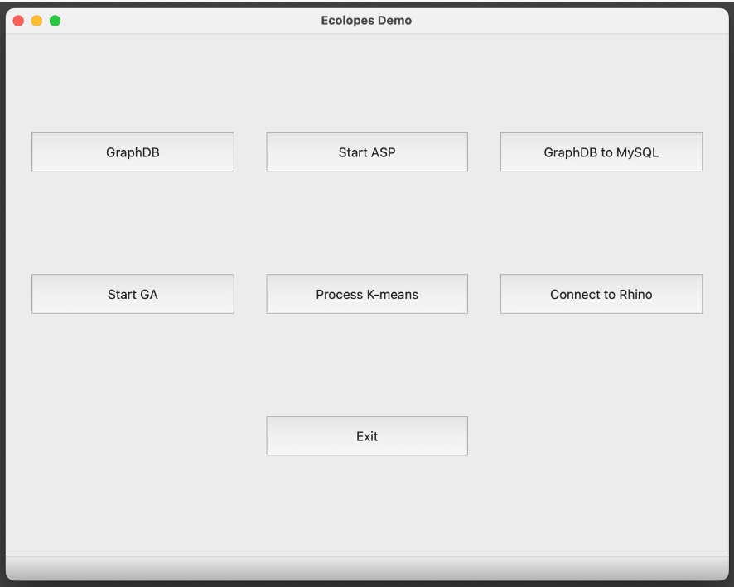
This is the main interface of ECOLOPES software, designed to assist architects and designers in utilizing machine learning and databases, such as graphs and MySQL, to connect to the Rhino3D environment.

Slide 4
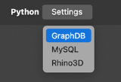
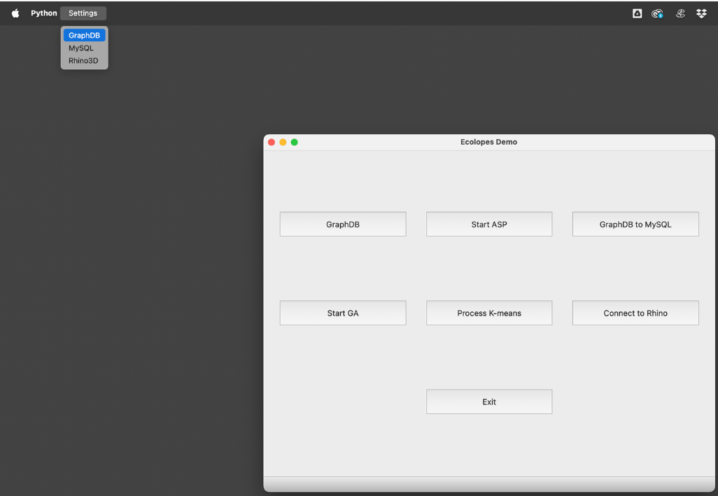
To begin, designers need to configure various settings, such as GraphDB settings to select the appropriate repository and MySQL settings to establish a connection between the Graph DB and MySQL. Finally, they must set up Rhino3D to integrate the software with the Rhino environment.

Slide 5
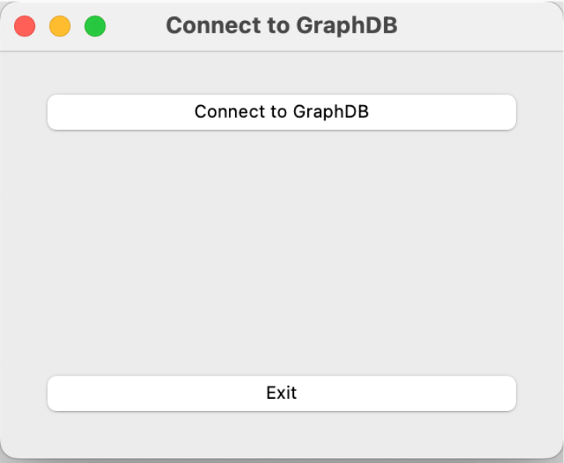
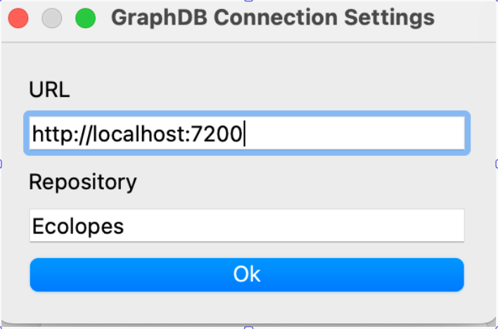
The figures illustrate the process of connecting to GraphDB, highlighting the crucial step of selecting the appropriate repository. Comprehensive documentation will cover all settings-related details.

Slide 6
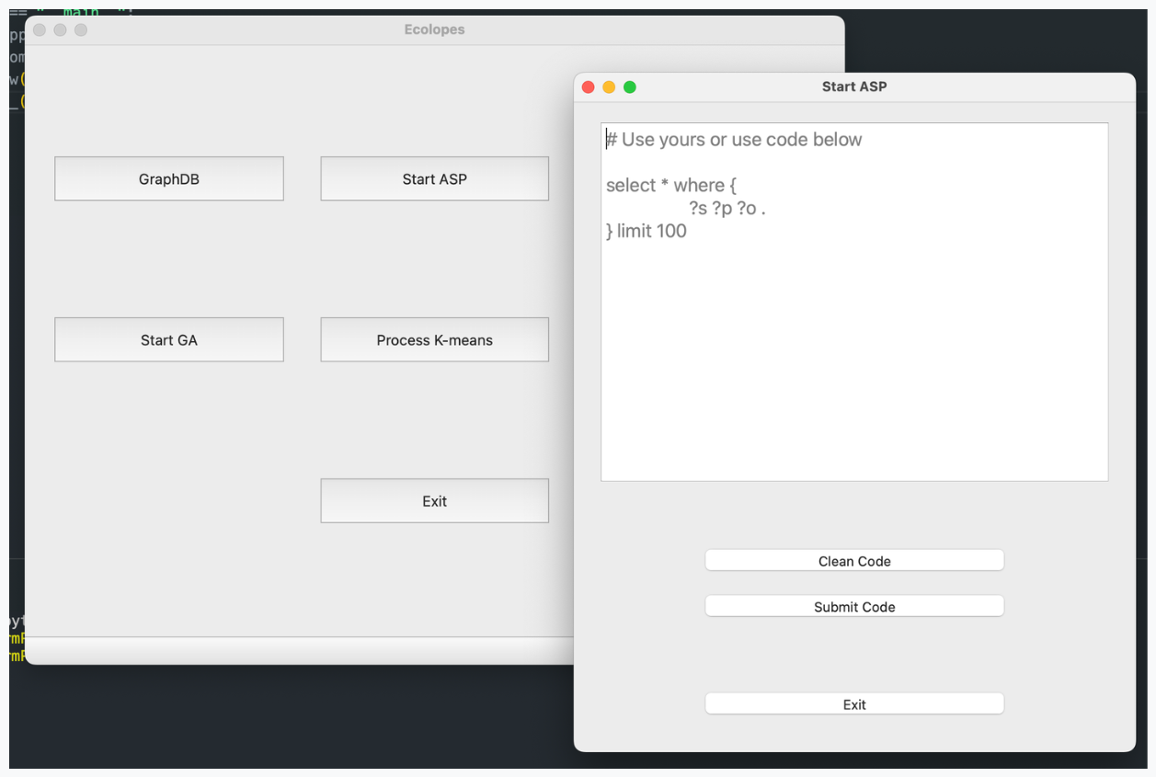
Once the settings are configured, designers can initiate ASP to input their queries or use pre-made queries in GraphDB. Designers will utilize ASP.

Slide 7
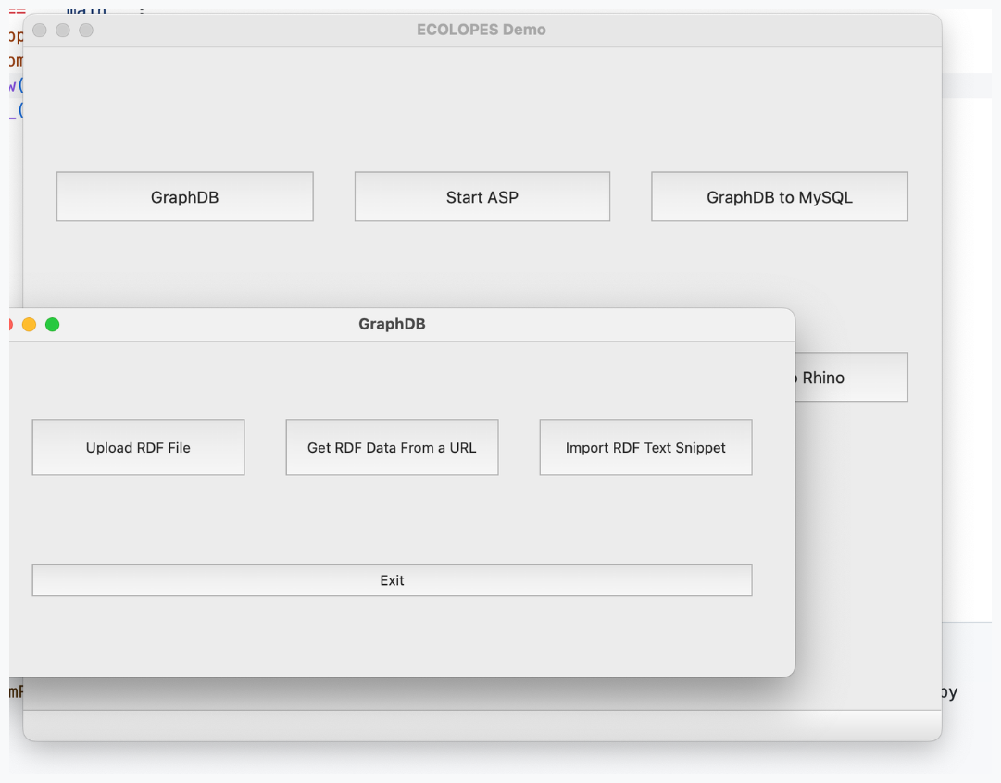
This section guides designers on creating, uploading, or importing a repository into the GraphDB environment.

Slide 8
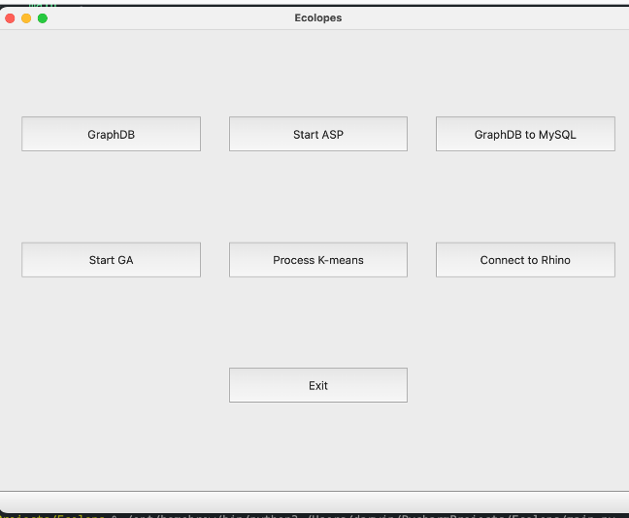
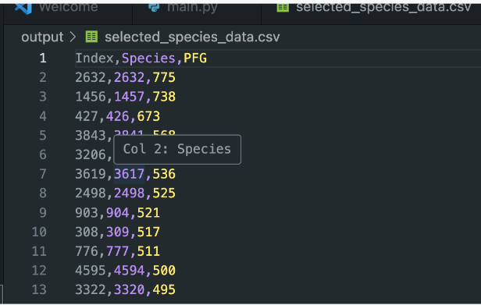
When ‘Start GA’ the button is clicked, the files are automatically downloaded from GraphDB into MySQL and converted into CSV format with numeric data types. This data is then inputted into the Genetic Algorithm for processing, and the results are saved in the output. Subsequently, the output is further processed by K-means.
OUTPUT

Slide 9
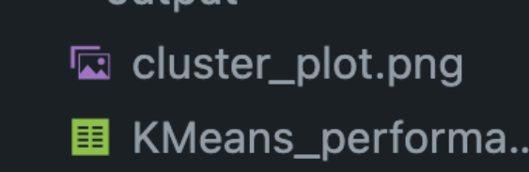

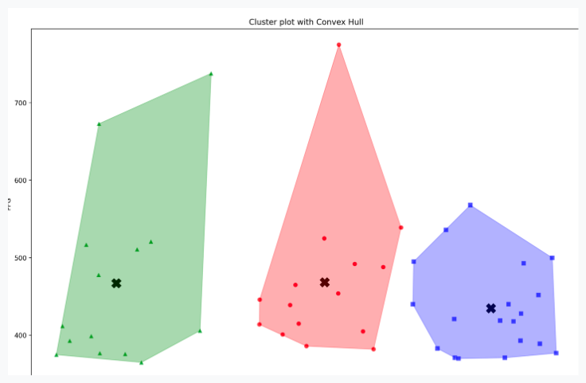
When the "K Means" button is clicked, the algorithm retrieves data generated by the genetic algorithm and processes it with a single click. The resulting output is then saved and serves as input for the Rhino3D software.

Slide 10
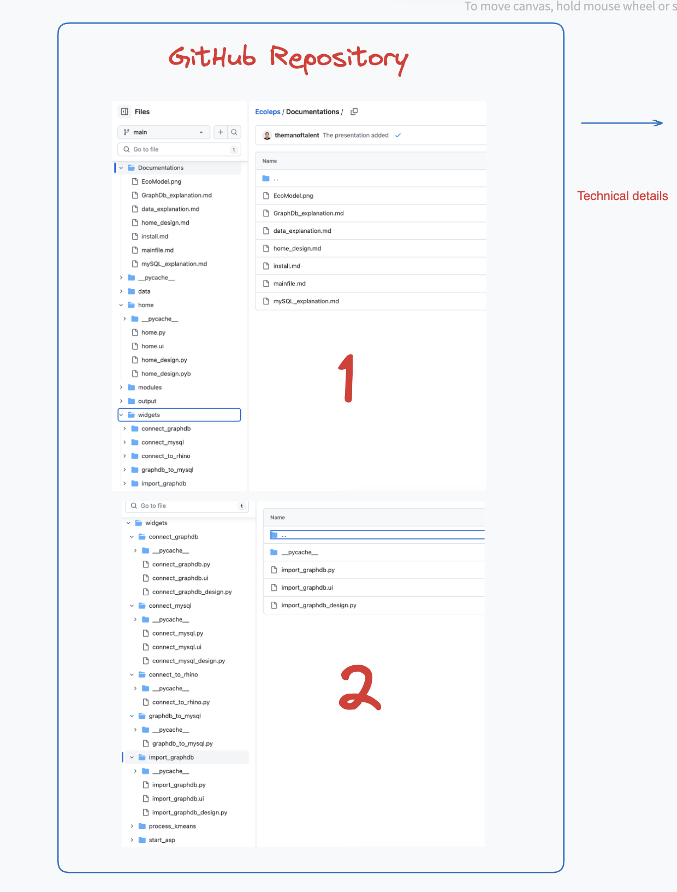
To convert a .ui file generated by Qt Designer to Python code,
we can use the following command:
python -m PyQt5.uic.pyuic -x name.ui -o name_design.py
The code is:
-py: Specifies that Python commands will be executed.
-m PyQt5.uic.pyuic: Runs the pyuic module provided by PyQt5, used to convert Qt Designer .ui files into Python code.
-x: Allows pyuic to generate an executable Python script directly.
name.ui: Replace this with the actual name of the Qt Designer .ui file we want to convert.
-o name_design.py: Specifies the output file, where pyuic will save the generated Python code from the .ui file.
python -m PyQt5.uic.pyuic -x home.ui -o home_design.py

Slide 11

Thank you

